Slide 1
To analyse circular motion
Success Criteria
I can draw circular motions diagram with velocity, acceleration and force
I can calculate velocity, acceleration and force for an object undergoing circular motion
I can describe centripetal force

Slide 2

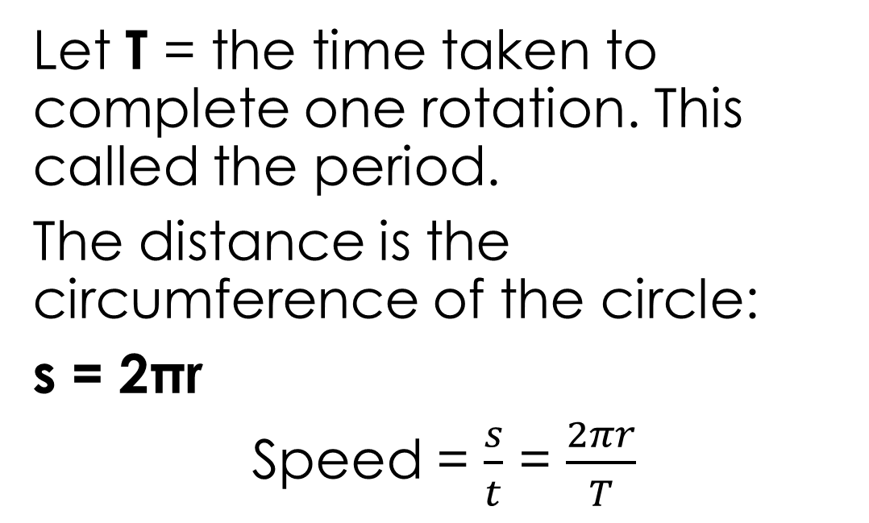
To analyse circular motion
Content Development
Consider a car steadily driving around a roundabout.
Let T = the time taken to complete one rotation. This called the period.
The distance is the circumference of the circle:
s = 2πr
Speed = $\frac{s}{t}$ = $\frac{2πr}{T}$
Notes:
Time it takes to complete one lap = T = a period
Distance = 2 pi r (circumference of the circle)
speed = s/d = 2πr / T

Slide 3



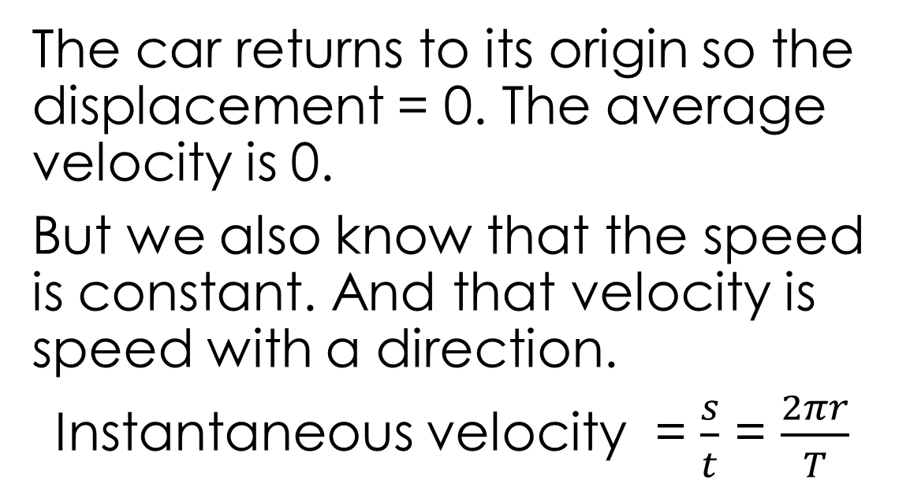

To analyse circular motion
Content Development
$$v$$
What is the velocity of the car?
The car returns to its origin so the displacement = 0. The average velocity is 0.
But we also know that the speed is constant. And that velocity is speed with a direction.
Instantaneous velocity = $\frac{s}{t}$ = $\frac{2πr}{T}$
$$v$$
$$v$$
$$v$$
tangential to the circular path

Slide 4


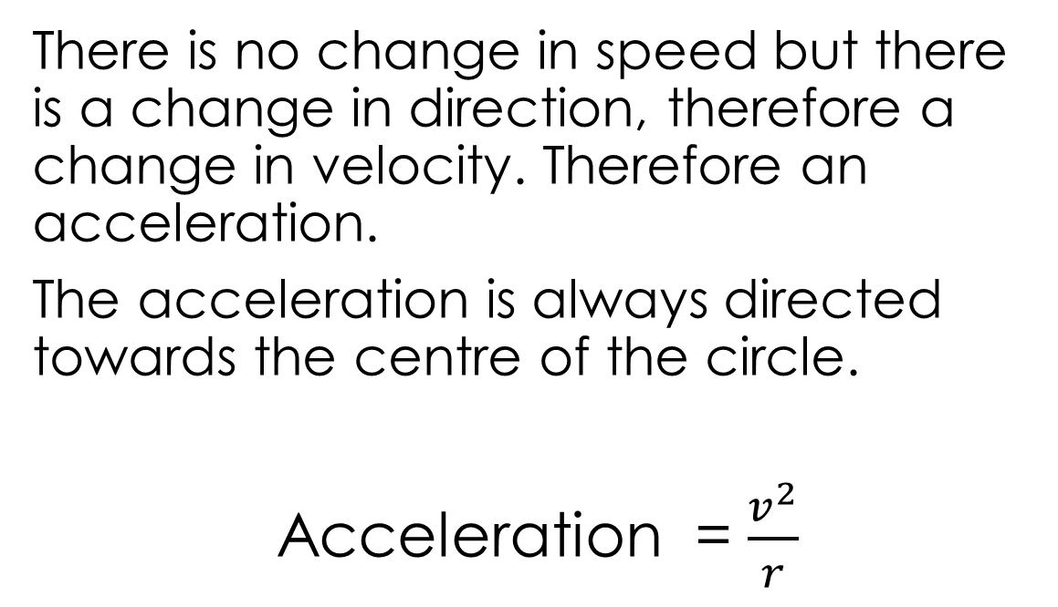
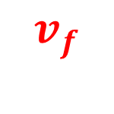
To analyse circular motion
Content Development
$$v$$
Is the car accelerating?
$$v_{f}$$
There is no change in speed but there is a change in direction, therefore a change in velocity. Therefore an acceleration.
The acceleration is always directed towards the centre of the circle.
Acceleration = $\frac{v^{2}}{r}$
$$v$$
$${−v}_{i}$$
$$Δv$$
$$v$$
$$v$$
towards the centre of the circle
Notes:
The velocity is always being pulled towards the centre.
Can show with vector addition (well, subtraction).
Δv = vf – vi = vf + (-vi)
The direction of the change in velocity between point i and f = the direction of the acceleration in that period.

Slide 5
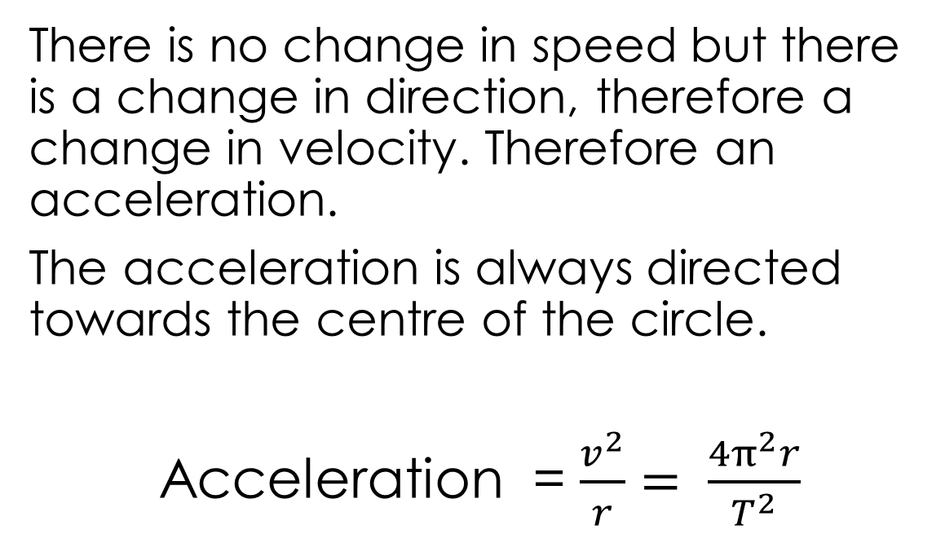
To analyse circular motion
Content Development
$$v$$
Is the car accelerating?
$$v_{f}$$
There is no change in speed but there is a change in direction, therefore a change in velocity. Therefore an acceleration.
The acceleration is always directed towards the centre of the circle.
Acceleration = $\frac{v^{2}}{r}= \frac{4π^{2}r}{T^{2}}$
$$v$$
$${−v}_{i}$$
$$Δv$$
$$v$$
$$v$$
towards the centre of the circle
Notes:
Show how to get to the full acceleration equation

Slide 6




To analyse circular motion
Content Development
$$v$$
Special word for this type of acceleration: centripetal
Centri = centrum → centre
Petal = petus → seeking
Centre-seeking
Non-scientists often say centrifugal. This is wrong.
Fugal = fugus → fleeing
The car is not fleeing the centre but is being pulled towards it
$$v$$
$$a$$
$$a$$
$$a$$
$$a$$
$$v$$
$$v$$

Slide 7




To analyse circular motion
Content Development
$$v$$
What do we know about the forces on the car?
There is an acceleration towards the centre, therefore there must be a net force towards the centre of the circle.
This is called the centripetal force.
$$v$$
$$F$$
$$F$$
$$F$$
$$F$$
$$v$$
$$v$$

Slide 8
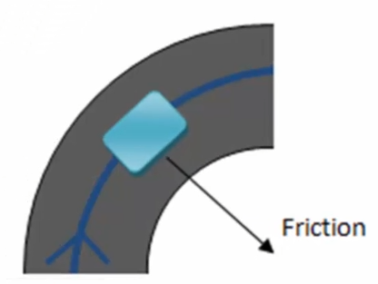
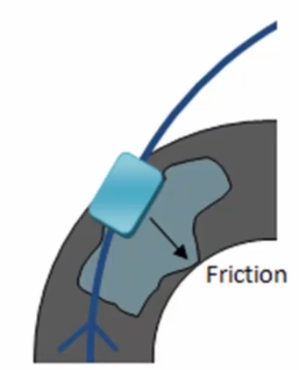
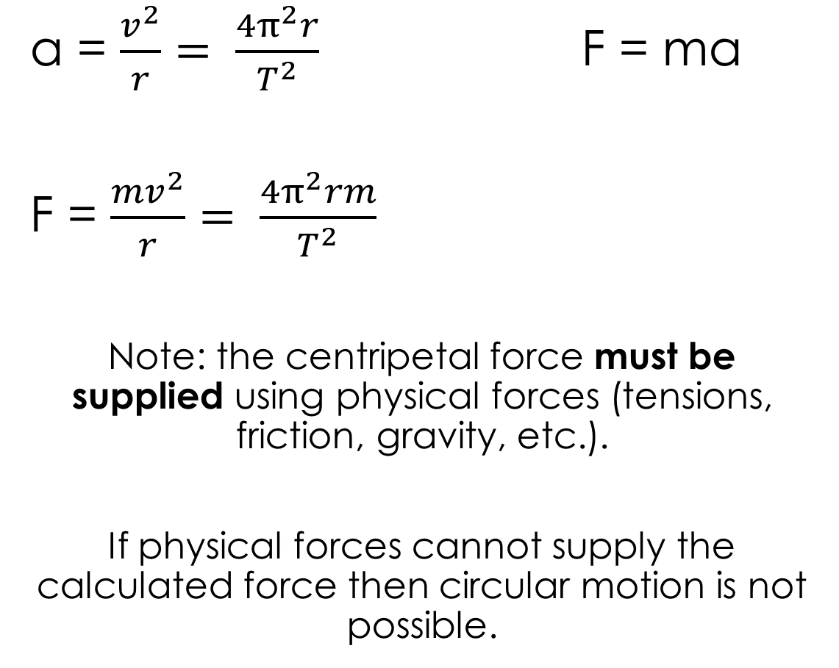
To analyse circular motion
Content Development
a = $\frac{v^{2}}{r}= \frac{4π^{2}r}{T^{2}}$ F = ma
F = $\frac{mv^{2}}{r}= \frac{4π^{2}rm}{T^{2}}$
Note: the centripetal force must be supplied using physical forces (tensions, friction, gravity, etc.).
If physical forces cannot supply the calculated force then circular motion is not possible.
Notes:
The supplied force is less than the centripetal force then the object will not continue in a circular path.

Slide 9
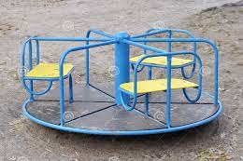
To analyse circular motion
Content Development
Ivan is on a merry-go-round, 6.10 m from the centre. Ivan has a mass of 56.0 kg. The merry-go-round completes a rotation every 8.70s.
Calculate:
Ivan’s velocity
Ivan’s acceleration
The frictional force acting on Ivan
Notes:
v = 2pi r / T = 2*pi*6.10 / 8.7 = 4.4054 = 4.41 ms^-1 tangential to the path
a = v^2/r = 4.4054^2 / 6.10 = 3.182 = 3.18 ms^-2 towards the centre
F = ma = 56.0 * 3.182 = 178 N
How does the frictional force change as r changes and as v changes

Slide 10
To analyse circular motion
Content Development
An athlete in a hammer throw event is swinging a ball of mass 7.0 kg in a horizontal circular path. The ball is moving at 20.0 ms⁻¹ in a circle of radius 1.60m.
Calculate the acceleration of the ball and the tensile force acting in the wire.
Notes:
A = v^2/r = 20^2 / 1.6 = 250ms^-2
F = ma = 7.00*250 = 1.75*10^3 N

Slide 11
To analyse circular motion
Content Development
Jeremy is on the edge of a 3.00m-wide playground merry-go-round, Jeremy has a mass of 35.0 kg. Jeremy falls off once the merry-go-round is spinning 0.85 times a second.
What is the centripetal force acting on Jeremy before he falls?
What supplies the centripetal force?
Why does Jeremy fall off at a certain speed?
Note:
Diameter provided, not radius.
Frequency provided, not period
Notes:
Frequency = 1/f = 1/0.85 = 1.176s
V = 2pi*r / T = 2*pi*1.5 / 1.176 = 8.014 m/s
a) F = mv^2/r = 35 * 8.014^2 / 1.5 = 1.50x10^3N towards the centre
b) Friction
c) As Jeremy’s velocity increases, required centripetal force increases. Friction can no supply enough the required centripetal force.

Slide 12
To analyse circular motion
Content Development
A tyre manufacturer claims they have produced the safest tyres in the world. Each tyre is capable of providing 20.0N of friction per kilogram of the car’s mass.
A car with those tyres approaches a corner at 80 km/h. The corner has a 17.0m curvature radius. Justify whether the car could follow the curve of the corner or not.

Slide 13
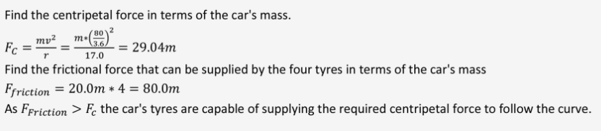
To analyse circular motion
Content Development
A tyre manufacturer claims they have produced the safest tyres in the world. Each tyre is capable of providing 20.0N of friction per kilogram of the car’s mass.
A car with those tyres approaches a corner at 80 km/h. The corner has a 17.0m curvature radius. Justify whether the car could follow the curve of the corner or not.

Slide 14
To analyse circular motion
Success Criteria
I can draw circular motions diagram with velocity, acceleration and force
I can calculate velocity, acceleration and force for an object undergoing circular motion
I can describe centripetal force

Slide 15
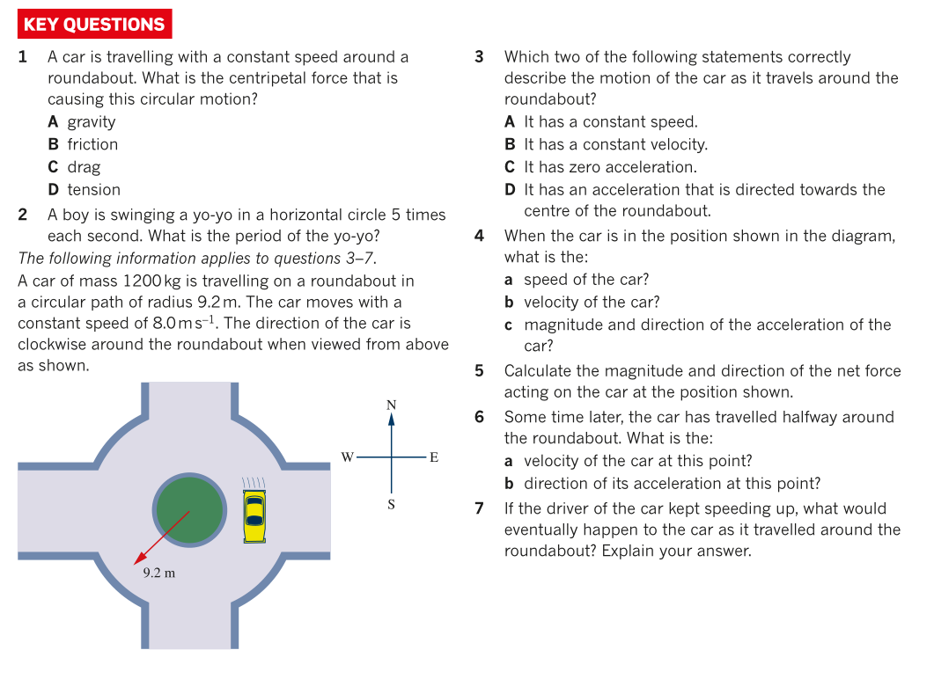

To analyse circular motion
Additional Study

Slide 16
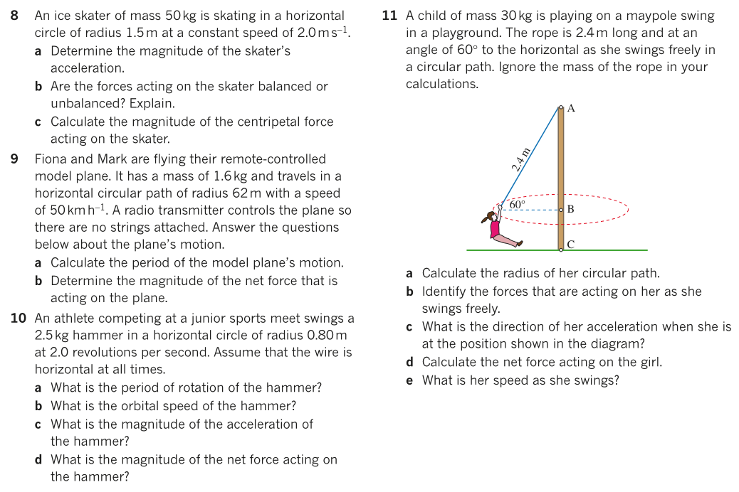
To analyse circular motion
Additional Study
Note: some of these questions need content from next pack (conical pendulums)

